Slide 1
IoT and M2M

Slide 2
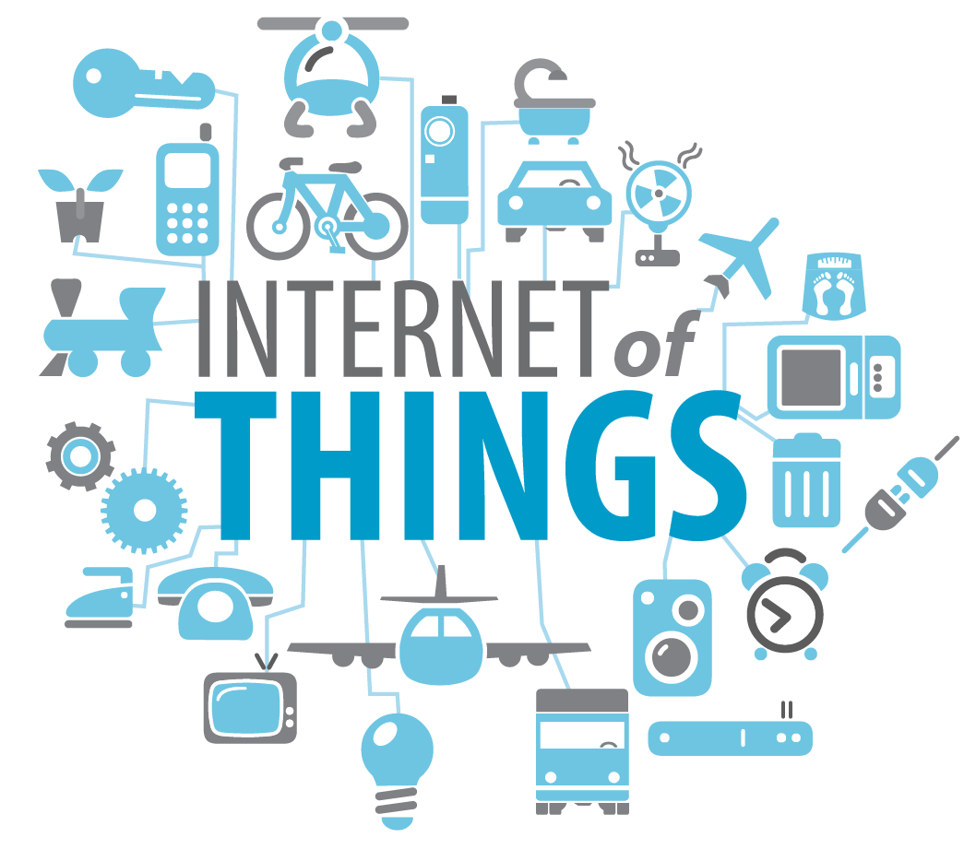
IoT in General
“Internet of Things” - concept
The Internet of Things (IoT) is the network of physical objects or "things" embedded with electronics, software, sensors and connectivity to enable it to achieve greater value and service by exchanging data with the manufacturer, operator and/or other connected devices.

Slide 3
Basic concept
“cheap” Embedded devices
Internet connectivity
…

Slide 4
Two main Perspectives
Internet - Network
Things - Objects
Protocols
M2M
Sensors
Integration of devices
Big Data

Slide 5
Examples
---

Slide 6
Companies

Slide 7
Technologies

Slide 8
Issues
Security

Slide 9
Recent work and achievements

Slide 10
Future
Human centric
Possible solutions and improvements
Standardisation

Slide 11
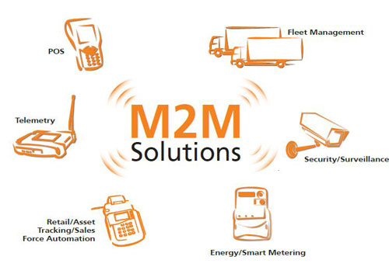
M2M in general
/*some kind of definition*/

Slide 12
Technologies

Slide 13
Issues

Slide 14
Current state

Slide 15
Future

Slide 16
Conclusion

